Slide 1

Introduction to FireMonkey
Part 1
Week of May 20th
The cross platform application development framework!
Windows, iOS, macOS, Android, and Linux*
*FMX Linux support comes from optional 3rd party add-ins

Slide 2
Live Labs & Office Hours
Thursday 23rd of May 10:00 AM MDT at
https://attendee.gotowebinar.com/register/7793455364685022220

Slide 3
In this section we cover
What is FireMonkey?
The FMX Form
FMX Layouts
FireMonkey Platform Services
Platform Default Behaviors
FireUI - Technology to Fine Tune Your UI
FMX Compared to VCL
Building Your First FireMonkey App
Follow along: https://embt.co/FmxMobileAppTraining

Slide 4
FireMonkey is Similar to VCL
Your VCL experience is applicable with FireMonkey
Many of the same components and concepts exist
It is not a 1:1 mapping of the VCL
Eg: TLabel.Text instead of TLabel.Caption
Designed to be cross-platform:
iOS, Android, macOS, & Windows
Other platforms like Linux via 3rd parties
Cross platform is in its DNA
Still uses the RTL you know and love

Slide 5
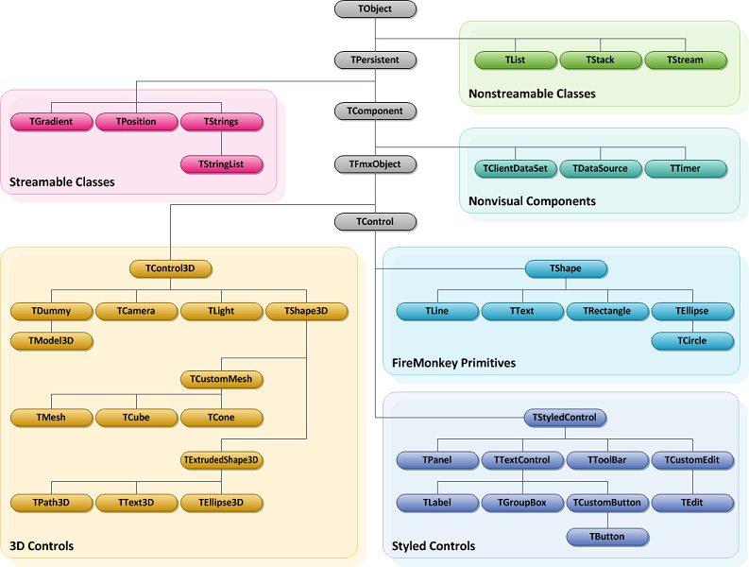
FireMonkey Object Hierarchy

Slide 6
FireMonkey Overview
FireMonkey also includes platform services and other non-visual components
Rendered by GPU
Uses DirectX on Windows
OpenGL on macOS
OpenGL ES on iOS & Android
Many animations and graphical effects
Check out the Quick Start Guide
docwiki:RAD/FireMonkey_Quick_Start_Guide_-_Introduction

Slide 7
The FireMonkey (.FMX) Form
Uses floating point numbers for positions, sizes, etc.
Supports animation and graphical effects
Very flexible controls: You can do more with fewer components
Many different layout & alignment options
TLayout, TFlowLayout, TGridLayout, TGridPanelLayout, TScrollBox, & TScaledLayout
None, Top, Left, Right, Bottom, MostTop, MostBottom, MostLeft, MostRight, Client, Contents, Center, VertCenter, HorzCenter, Horizontal, Vertical, Scale, Fit, FitLeft, FitRight
Robust and customizable styling system
All components are nestable: Instead of TBitBtn, put TImage on TButton
The .FMX file is very similar to a VCL .DFM file
The Enumerated properties are Scoped Enums, and don’t typically have type prefixes (i.e. Align of Client vs. alClient)

Slide 8
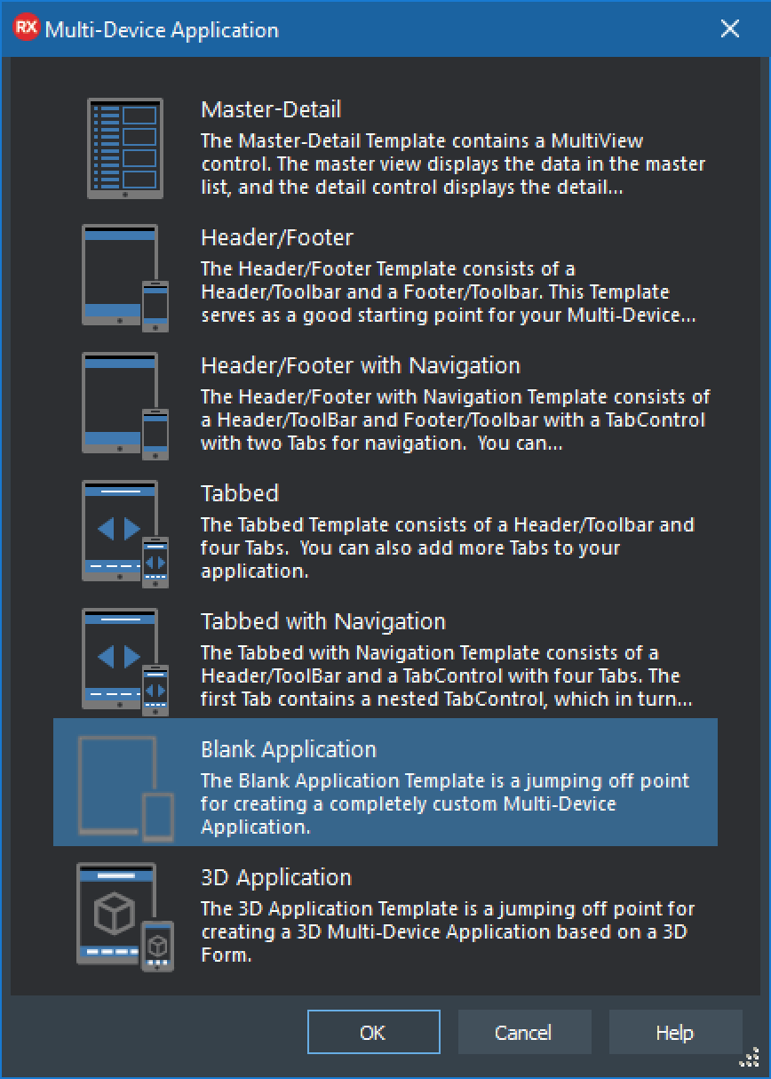
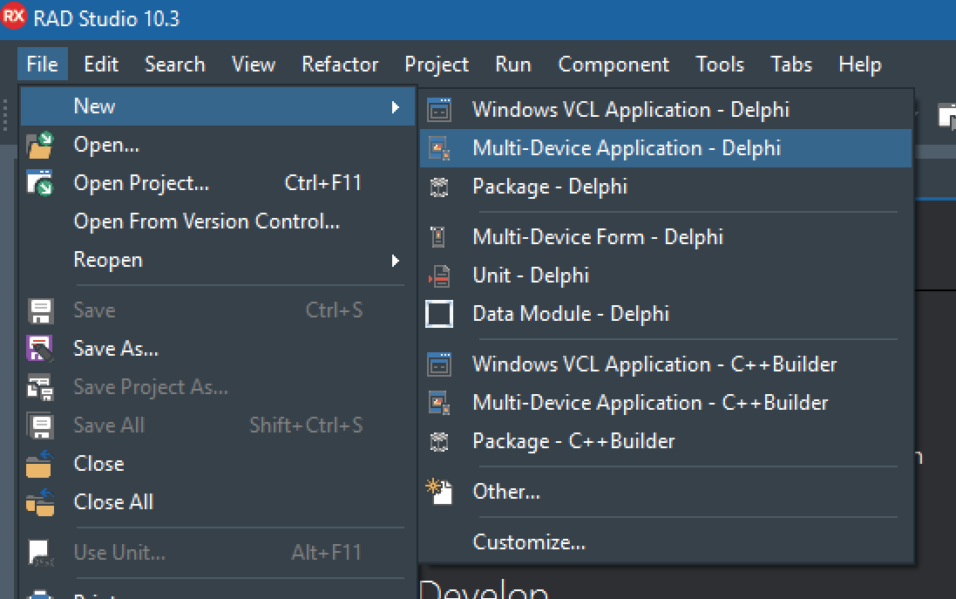
Creating a FireMonkey Project
Listed as “Multi-Device Application”
Available for Delphi or C++Builder
Presents you a dialog to choose a template
In some versions 2D FMX is called HD
3D FMX applications are different from 2D, & won’t be covered. You can learn more about them in the DocWiki though!
Notes:
You can reach any template from the “Blank Application” that is what we are starting with.

Slide 9
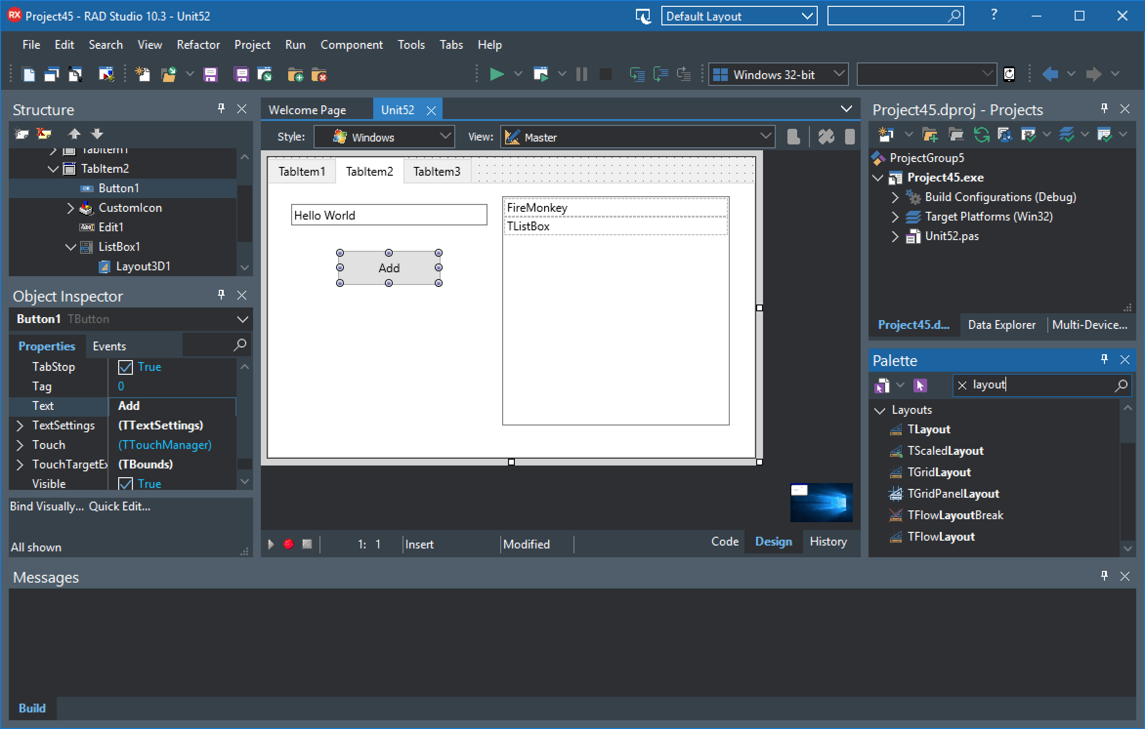
Hide/Show Non-Visual Components
Design Style
Platform style to show in designer
Custom Views
Created & edited for specific platforms & form-factors
Platform Selector
Choose target for compiler, and device for deployment.
Theme
Layout
IDE Insight
Structure view
Hierarchical view of visible and non-visible components on form
Project Manager
Hierarchical view of all files in project or project group
Object Inspector
View and edit properties and events of selected component(s) or form.
Notice the TButton has a Text property instead of Caption, otherwise very similar to VCL.
Design
Surface
Data Explorer
Access & explore data sources
Multi-Device Preview
Preview your UI across different form factors
Palette
Only shows FireMonkey controls. They might appear disabled if not supported on the current platform.
Messages: Compiler output, etc.

Slide 10
Understanding Platform Default Behavior
Many properties have an option of PlatformDefault value
This will change the value based on the platform
Tab Controls PlatformDefault property http://embt.co/TutorialTabPages
The Style can apply properties too based on platform
This is controlled with the StyledSettings property
Settings text parameters http://embt.co/SettingTextParameters
Change the ControlType property from Styled to Platform
Currently supporting iOS, Android, and Windows coming soon
More information: http://embt.co/FMXNative

Slide 11

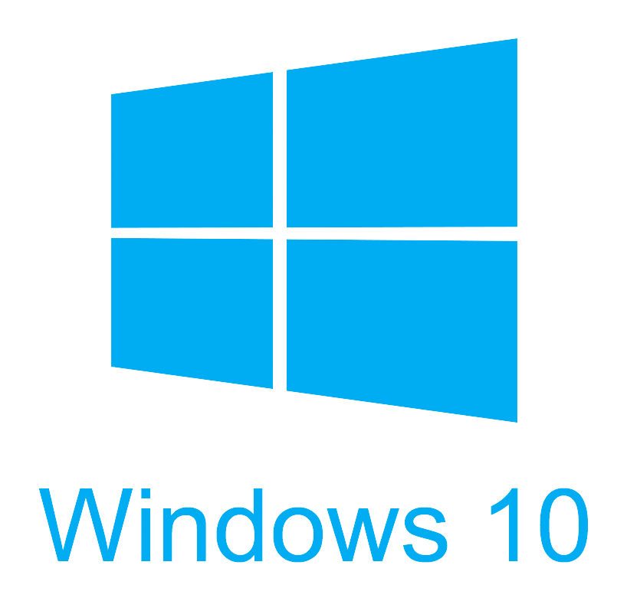
Lab - Hello FireMonkey
Create a FireMonkey app for Windows
Add a TTabControl, then right click and “Add TTabltem”
Include TLabel, TButton, TEdit, & TListBox on one of the TTabItems
Notice TLabel & TButton have Text instead of Caption properties
Notice the TTabControl has TabPosition of PlatformDefault
In the OnClick event handler add the following code:
ListBox1.Items.Add(Edit1.Text);
Compile and run your app on Windows
Beaker image https://pixabay.com/photo-23417/

Slide 12
FireMonkey Platform Services
A FireMonkey interface that defines functionality that might or might not be implemented on a particular run-time platform
Allows for different functionality and implementation per platform
FireMonkey implements over 50 platform services
You can implement your own platform services
Use TPlatformServices.AddPlatformService and TPlatformServices.RemovePlatformService
For example, you can unregister one of the built-in platform services and replace it with a new implementation of the platform service that is tailored to fit your needs.
More information on Platform Services http://embt.co/PlatformServices

Slide 13


Lab - FireMonkey Platform Services
Working with your lab from earlier, add Clipboard support
Take a look at http://embt.co/PlatformServices
Add FMX.Platform & FMX.Clipboard to your uses clause
Interact with the clipboard via Platform Services
uses FMX.Platform, FMX.Clipboard; procedure TFormFMXLab2.Button2Click(Sender: TObject); var ClipboardService: IFMXExtendedClipboardService; begin if TPlatformServices.Current.SupportsPlatformService( IFMXExtendedClipboardService, ClipboardService) then begin if ClipboardService.HasText then ListBox1.Items.Add(ClipboardService.GetText); ClipboardService.SetText('Hello FireMonkey'); end; end;
Clipboard image https://pixabay.com/photo-155885/

Slide 14
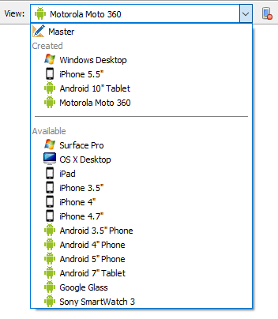
FireUI Device Views
Allows you to add platform specific customized views to your layout
Each device specific view is a collection of changes to the master view
Allows for customization based on OS, form factor, etc.
Easily customize to add your own devices
At runtime the closest view is automatically used
docwiki:RAD/Using_FireMonkey_Views

Slide 15
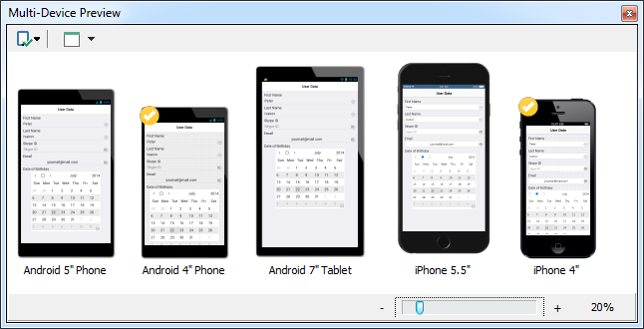
FireUI Multi-Device Preview
Accessible via: View > Tool Windows > Multi-Device Preview
docwiki:RAD/Multi-Device_Preview

Slide 16
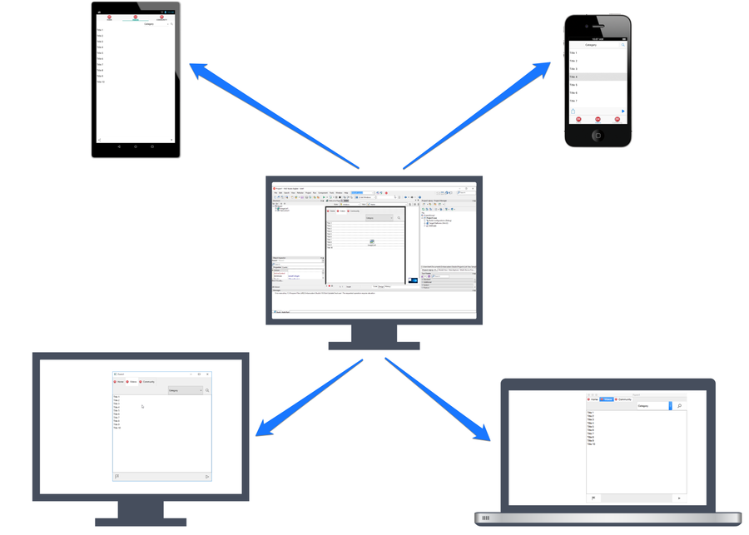
FireUI Live Preview
Live UI preview on physical device
Uses app tethering technology to connect over local network
Preview app available via the app store
Recompile from code to add custom components
docwiki:RAD/FireUI_Live_Preview

Slide 17

Working with Databases
(Just an introduction - more on this later)
FireMonkey works with any database components
FireDAC is the new, high performance, cross platform, multi-database component framework that is included “in the box”
On mobile FireDAC supports SQLite, IBLite (Free), & IBToGo (IBToGo adds encryption and more for a license fee)
FireDAC Overview: embt.co/FireDACOverview
FireDAC Mobile Tutorial: embt.co/FireDACMobile
FireMonkey doesn’t have specific data aware controls, instead any component can be connected to any data via LiveBindings
embt.co/LiveBindings

Slide 18
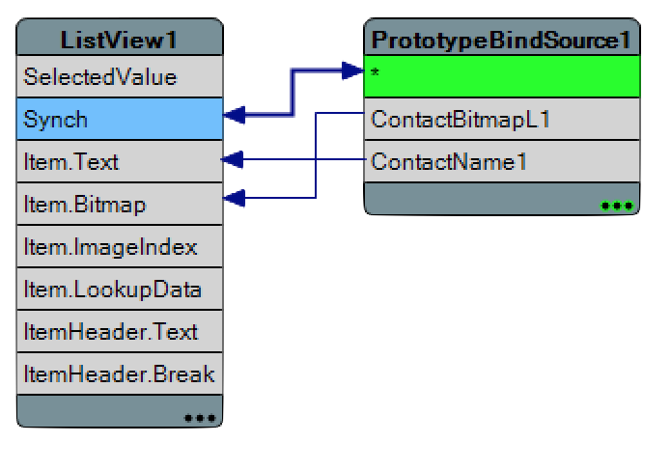

Lab - FireMonkey LiveBindings
Add a TPrototypeBindSource
Dbl Click -> Add ContactBitmapsL & ContactNames
Add TListView
Find the ItemAppearance.ItemAppearance property
Change it from ListItem to ImageListItem
Set ItemAppearanceObjects.ItemObjects.Visible to False
Right Click ListView1 -> Bind Visually…
Connect:
Sync -> *
Item.Text -> ContactName1
Item.Bitmap -> ContactBitmatL1

Slide 19
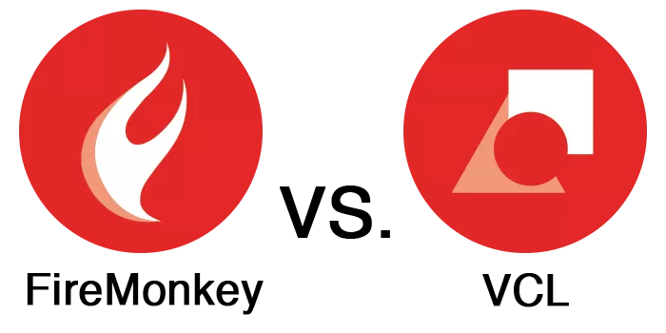
delphi.org/2016/10/firemonkey-vs-vcl/
Notes:
FMX Compared to VCL
Similarities
What are advantages?
What are limitations?

Slide 20
More FireMonkey UI
More on layouts and UIs https://embt.co/MoreFmxUI
DocWiki
docwiki:RADStudio/FireMonkey
docwiki:RADStudio/FireMonkey_Quick_Start_Guide_-_Introduction
docwiki:RADStudio/FireMonkey_Components_Guide
docwiki:RADStudio/FireMonkey_Applications_Guide
docwiki:RADStudio/Multi-Device_Applications_Index
docwiki:RADStudio/FireMonkey_Tutorials
docwiki:RADStudio/FireMonkey_3D
docwiki:RADStudio/Tutorial:_Creating_a_FireMonkey_3D_Application
docwiki:RADStudio/FireMonkey_Component_Library
docwiki:Libraries/FMX Unit List

Slide 21
In this section we covered
What is FireMonkey?
The FMX Form
FMX Layouts
FireMonkey Platform Services
Platform Default Behaviors
FireUI - Technology to Fine Tune Your UI
FMX Compared to VCL
Building Your First FireMonkey App

Slide 22
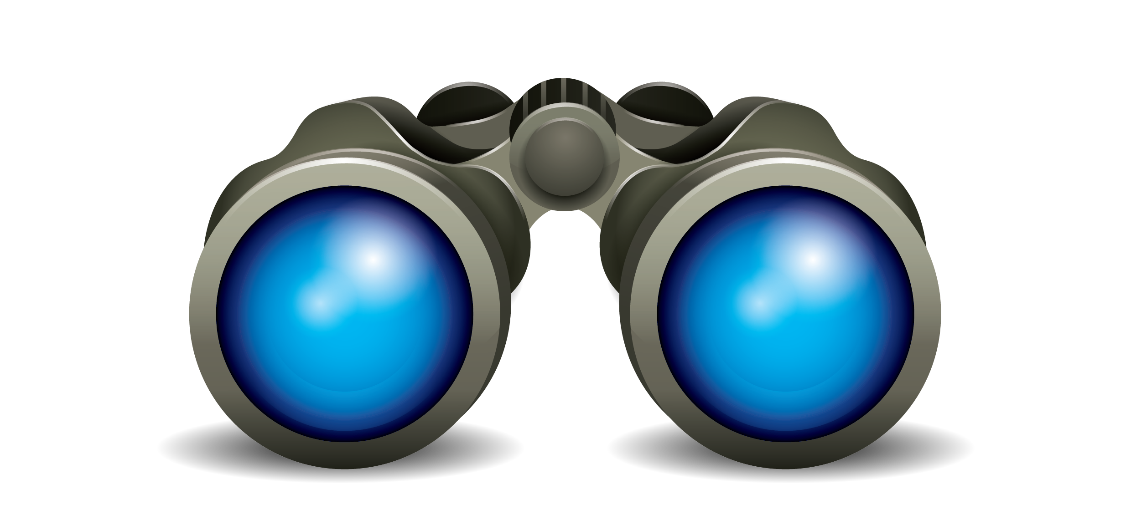


Up Next...
Setting Up Mobile Development
Focus on Android, but also touch on iOS

